Slide 1
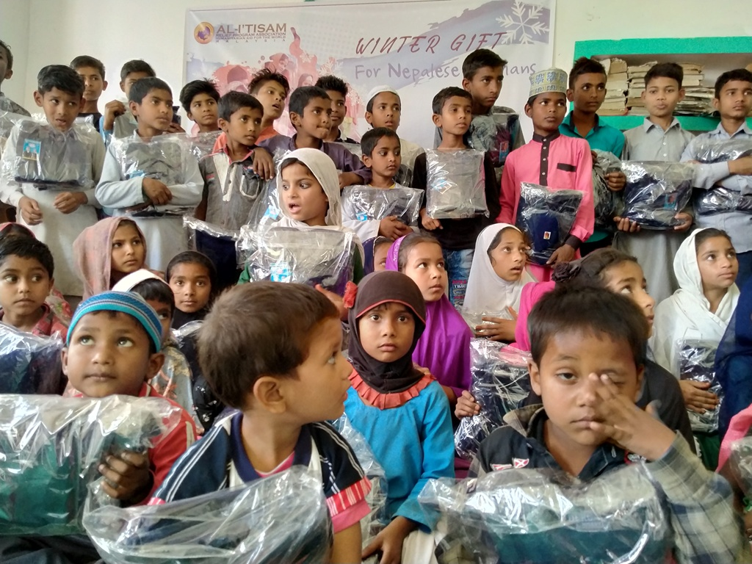
Annual Report
2020-21
Human Relief Organization Nepal
Serving Humanity

Slide 2
Message from Secretary General
Country Context
Who We are
Geographic Intervention
Impact at Glance
Focus Areas
Highlights 2020-21
Financial Review
Our Partners
HRO Nepal Contribution in SDG Goals
Table of Content

Slide 3
Message from the Secretary General
Ghufran Ahmad Shakir
It is with immense gratitude and deep humility that I extend my heartfelt appreciation to all who have supported Human Relief Organization Nepal (HRO Nepal) on our journey to serve humanity. Since our inception, our unwavering commitment has been to uplift the most vulnerable members of society and respond to human suffering with compassion, dignity, and purpose.
I am proud of our dedicated team, volunteers, and community leaders whose selfless efforts drive our success. We are equally grateful to our partners and donors worldwide for their trust and support, which enable us to expand our reach and impact.
Together, we have turned compassion into action and will continue working for a better, more inclusive, and resilient Nepal. Let us reaffirm our commitment to serve humanity with sincerity, transparency, and love, and invite all to join hands with HRO Nepal in building a future where every life is valued.
May God (SWT) guide and bless our efforts.
Warm regards,

Slide 4
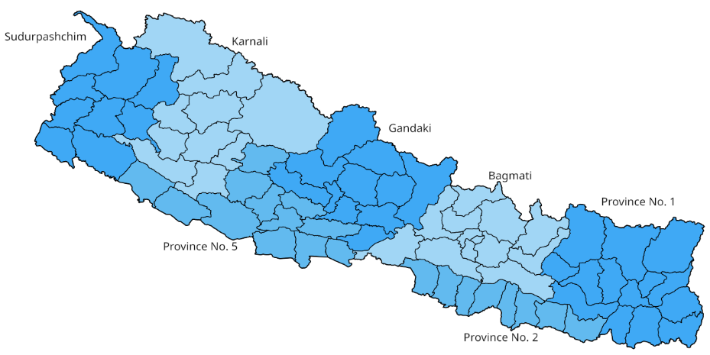
Country Context
Nepal, a culturally rich, multi-ethnic, and multi-religious nation in South Asia, became a Federal Democratic Republic in 2015 under its new Constitution, which established seven provinces, 77 districts, and 753 local governments with significant autonomy in planning, resources, and decision-making. The Constitution promotes Gender Equality and Social Inclusion (GESI), ensuring greater representation for women, youth, and marginalized communities.
Despite these progressive provisions, Nepal faces persistent development challenges. Policy gaps, weak implementation, and poor intergovernmental coordination limit progress. While infrastructure has advanced, social development in health, education, and child protection lags behind. Community schools often lack child-friendly environments, contributing to high dropout rates, especially in higher grades. Youth unemployment drives significant labor migration, and marginalized rural areas continue to face inadequate healthcare, water, and sanitation, resulting in high maternal and child mortality and malnutrition.
Agricultural productivity remains low due to limited modernization, while frequent natural disasters—floods, landslides, fires, and epidemics—threaten lives and livelihoods. Harnessing Nepal’s diversity for inclusive, sustainable, and resilient development requires coordinated efforts from government, civil society, and development partners.

Slide 5


Who we are ?
Human Relief Organization Nepal (HRO Nepal) is a dedicated non-governmental, non-commercial entity committed to enhancing the lives of marginalized communities across Nepal. With a focus on creating sustainable and positive change, HRO Nepal operates through a diverse array of social, educational, and healthcare initiatives. The organization is steadfast in its mission to ensure access to quality education, support orphans and destitute children, empower youth through skills development, provide clean water, address malnutrition and food insecurity, offer free medical services, support healthcare facilities, and respond to crises and natural disasters. By tackling these critical areas, HRO Nepal strives to uplift communities and foster a brighter, healthier future for all.
Vision: As a leader to empower lives, creating opportunities and strengthen the bond of humanity.
Mission: HRO Nepal is committed to serve humanity by integrating resources for people in need. We strive to provide immediate response in disasters, and effective programs in place of suffering for the pleasure of Almighty God.
Goal: To uplift and transform the lives of marginalized and vulnerable communities across Nepal by providing integrated social, educational, and healthcare services, promoting self-reliance, and fostering sustainable development for the pleasure of Almighty God.
Core Values:
Mutual Respect: Recognize the innate worth of all people and the value of diversity
Equity and Justice: Work to ensure equal opportunity for everyone, irrespective of race, gender, color, class, ethnicity, disability and location
Care for All: Provide care for vulnerable groups; orphans, widows and elderly people
Honesty and Transparency: Being accountable at all levels for the effectiveness of our actions and open in our judgments and communications with others
Self -Respect: To help the poor without the feeling of humiliation
Solidarity with the Poor: Powerless and excluded will be the only bias in our commitment to the fight against poverty

Slide 6

Promote Inclusive and Quality Education
Deliver Emergency Relief and Disaster Response
Foster Community Resilience and Solidarity
Improve Access to Clean and Safe Water
Enhance Livelihoods through Skills Development
Provide Healthcare Services and Surgeries
Combat Malnutrition and Food Insecurity
Objectives

Slide 7


Legal Status
Human Relief Organization Nepal is officially registered with the District Administration Office, Taulihawa, Kapilvastu under Registration No. 107/054-55. It is affiliated with the Social Welfare Council (Affiliation No. 32654) and is also registered with the Internal Revenue Office, Kapilvastu, under PAN No. 300363568.
Geographic Intervention
In the fiscal year 2020–2021, Human Relief Organization Nepal positively impacted the lives of over 13,408 individuals across Five districts (Kapilvastu, Rupendehi, Sunsari, Morang and Japa) in Nepal through a wide range of humanitarian and development interventions.
Despite operating in complex and often unpredictable environments, the organization remained steadfast in its commitment to uplifting communities facing poverty, displacement, and crisis.
Our dedicated teams worked tirelessly to adapt to evolving needs, delivering timely and essential support to the most vulnerable populations. Through this unwavering effort, HRO Nepal not only responded to emergencies but also laid the groundwork for long-term resilience and sustainable development.

Slide 8

Emergency Response
Skill Development & Livelihood
Seasonal Program
Health Care
WASH- Water For Life
Orphan and Destitute Support
Education for All
Our Focus Areas

Slide 9
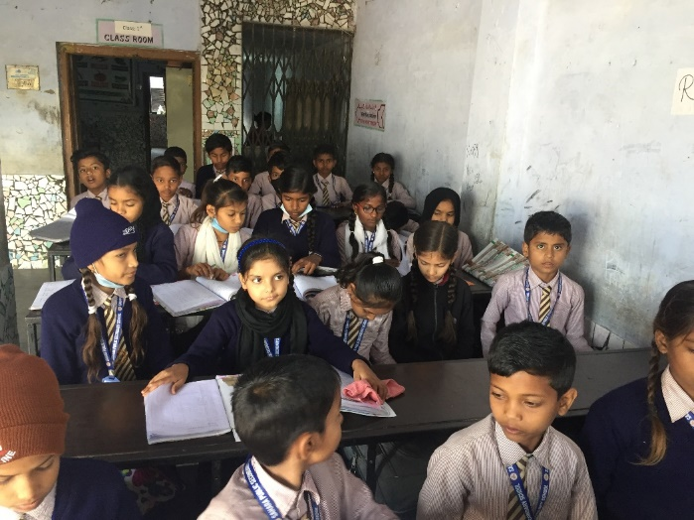

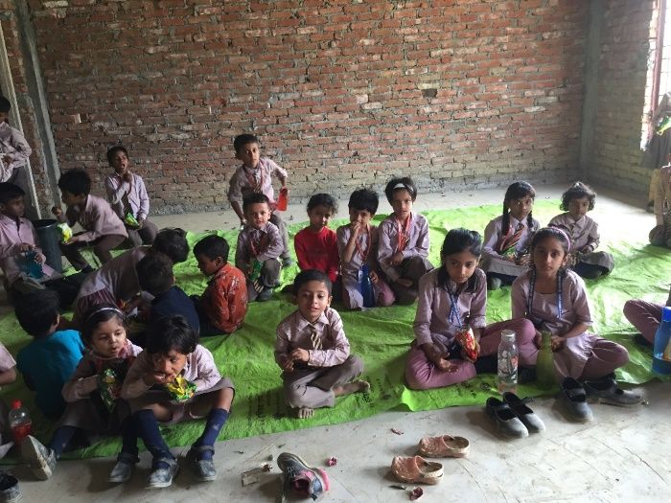
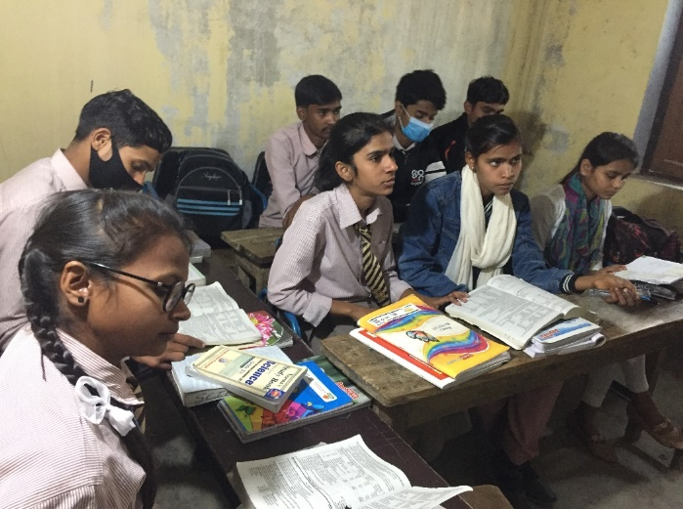
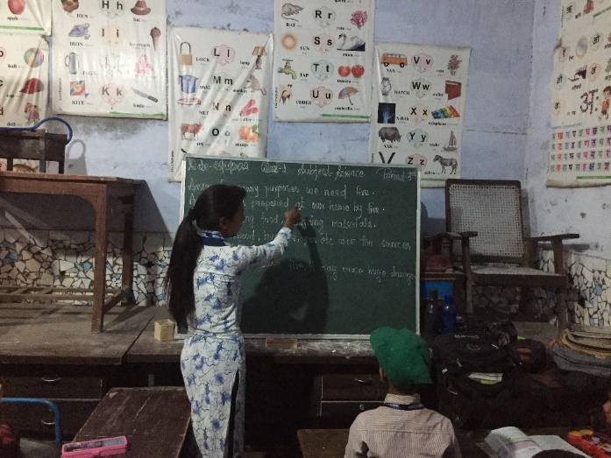
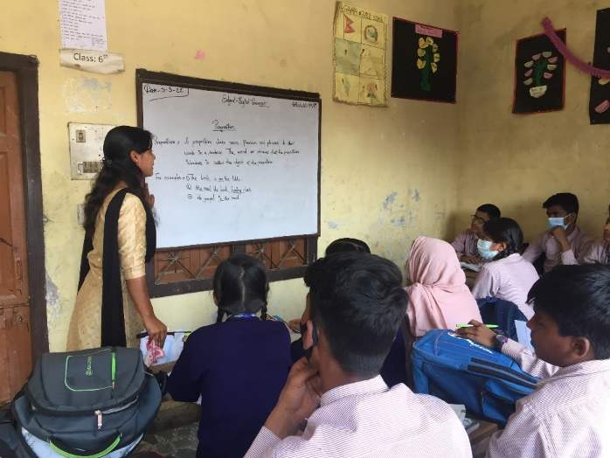
Highlights 2020-21
Education for All
Sahara Public Secondary School
Education is central to Human Relief Organization Nepal’s mission, ensuring every child—regardless of background—has the chance to learn and succeed. Through our Education Project, we provide scholarships, sponsorships, and academic support to underprivileged children, including orphans, those with disabilities, and students from marginalized communities. This year, a key milestone has been our ongoing support to Sahara Public Secondary School in Krishnanagar, Kapilvastu, where (305) students now have access to quality education—empowering them with knowledge, skills, and confidence for a brighter future.

Slide 10
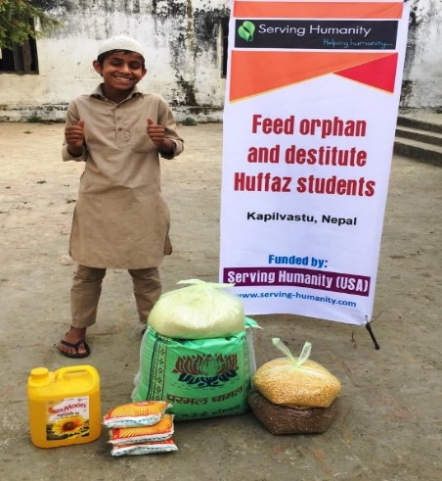
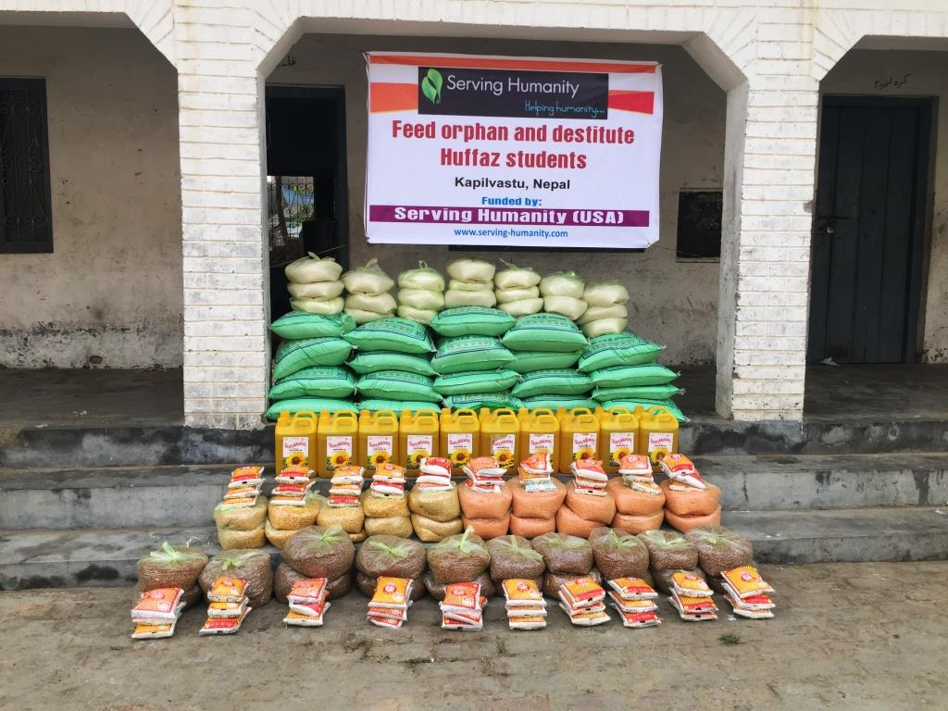
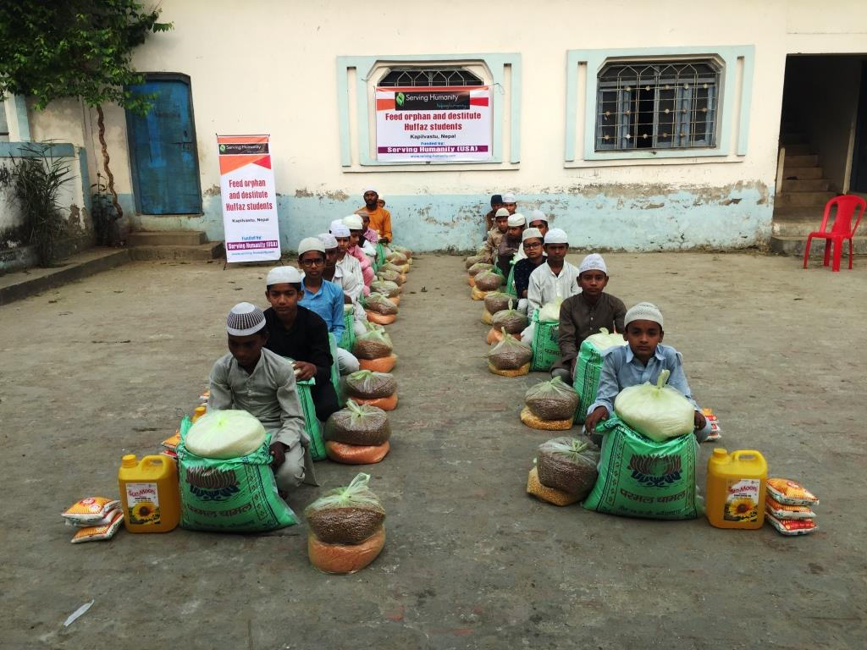
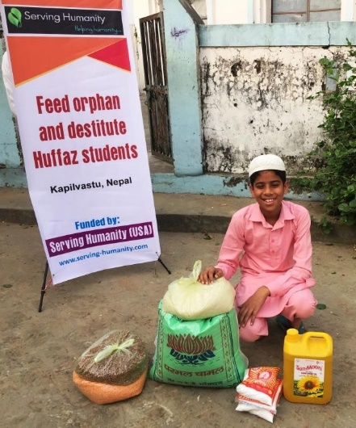
Feed Orphans and Destitute Huffaz Students
HRO Nepal distributed food packs to (20) orphans and destitute Hufāza students at Madrasa Darul Quran for the Memorization of the Holy Quran, located in Maharajganj Municipality–10, Mujahni, Kapilvastu District. This initiative aimed to support vulnerable children from disadvantaged backgrounds by addressing their immediate food needs and ensuring they could continue their Quranic education without the stress of food insecurity.
The support had a meaningful impact on both the students and the wider community. It improved the nutrition and well-being of the beneficiaries, reduced the financial burden on their guardians and caretakers, and helped create a more stable and encouraging learning environment. By meeting these essential needs, HRO Nepal reinforced its commitment to empowering orphans and underprivileged children, promoting education, and fostering hope and dignity within the community.

Slide 11

200 orphans from 54 Madrasas, government schools and private schools in Kapilvastu
Hygienic Kits Distribution
Study Kits Distribution
Health Screening
Winter Relief
OSP
Financial Support
Educational Tour
Co-Curriculum activities

Slide 12

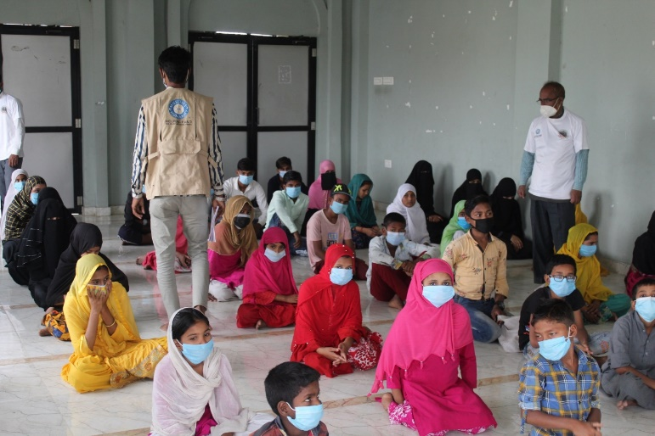
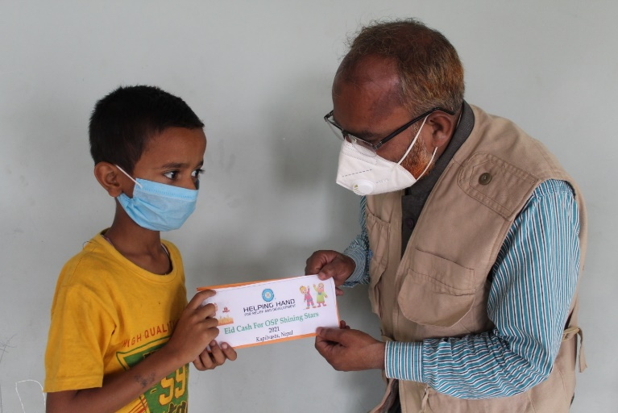
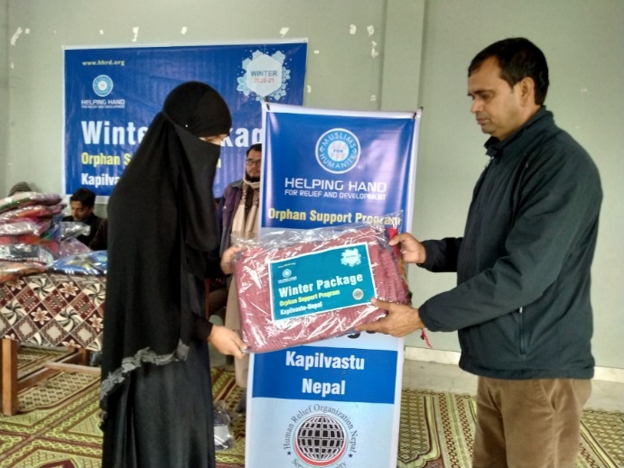
Orphan Support Program
HRO Nepal continues to prioritize the well-being of (200) orphaned children through its Orphan Support Program (OSP), which offers holistic care focusing on education, health, and emotional support. This year, orphaned children received regular financial assistance, nutritious food packages, hygiene kits, school supplies, and educational materials to support their daily and academic needs.
Seasonal initiatives such as “Winter – A Gift of Warmth” and “Festival Eid Cash Gifts” brought joy and inclusion during special occasions. The program also provided regular health check-ups, organized educational tours, co-curricular activities, tree plantation drives, and interaction sessions with OSP mothers to strengthen family care and emotional well-being.
Through this program, HRO Nepal remains deeply committed to nurturing orphaned children in a safe and supportive environment, helping them grow into confident and capable individuals.

Slide 13
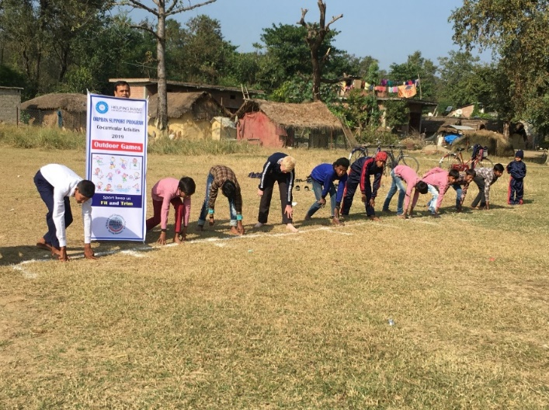
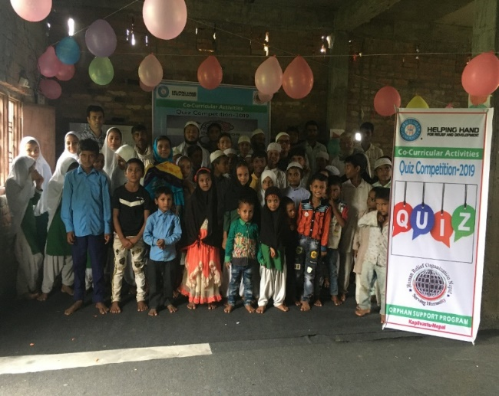
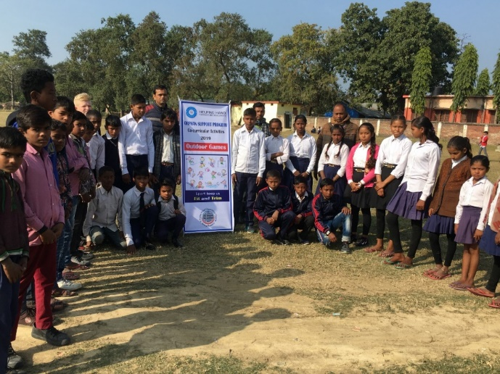
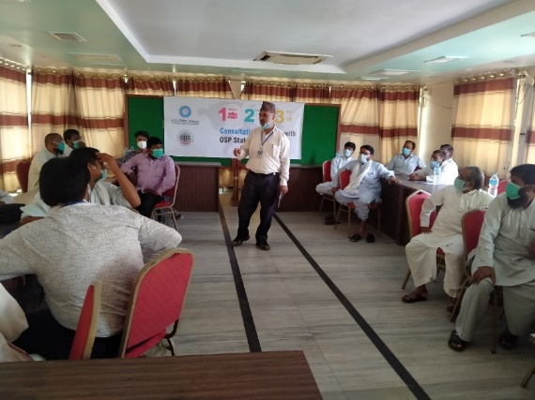
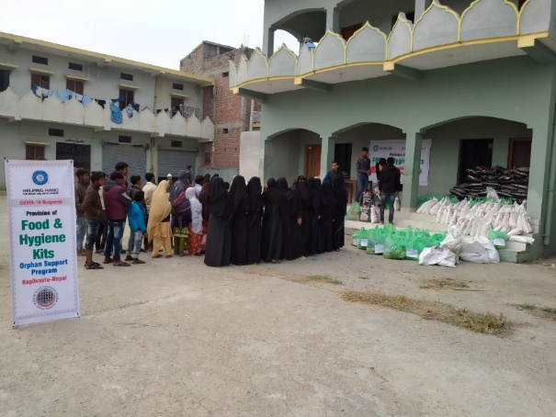
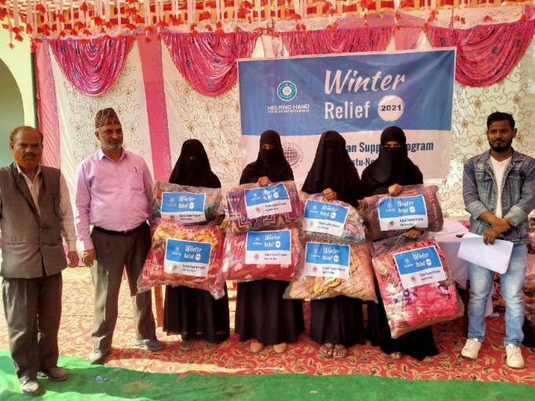
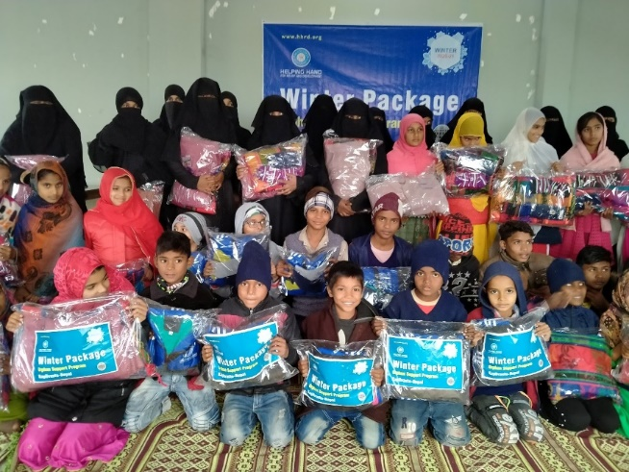
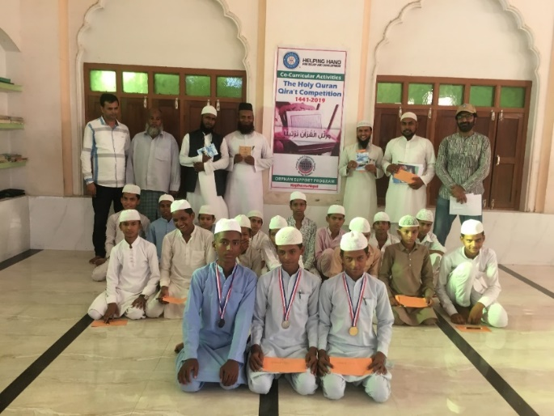
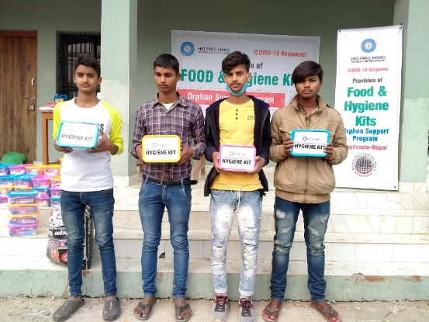
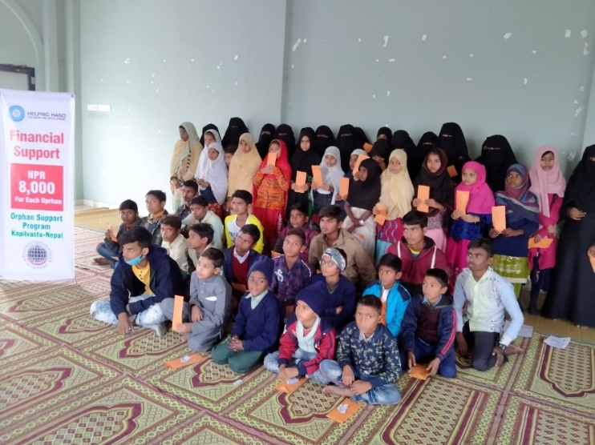
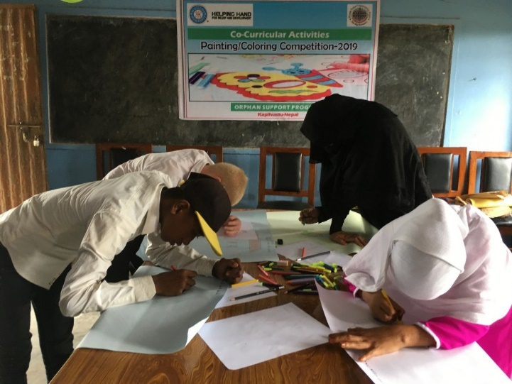
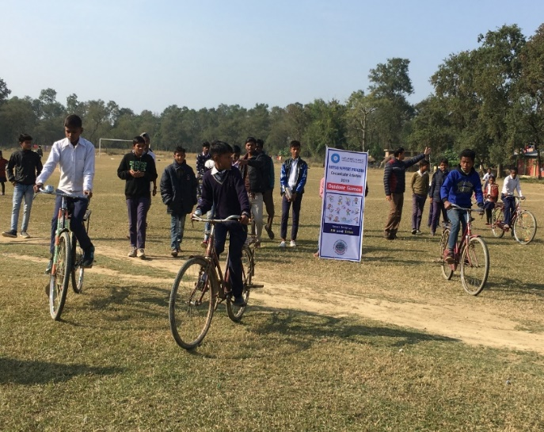

Slide 14
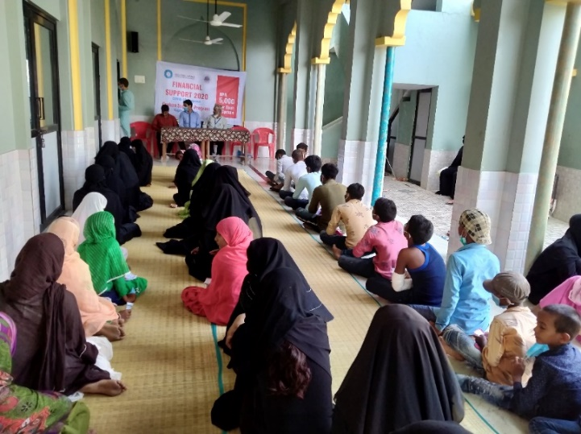
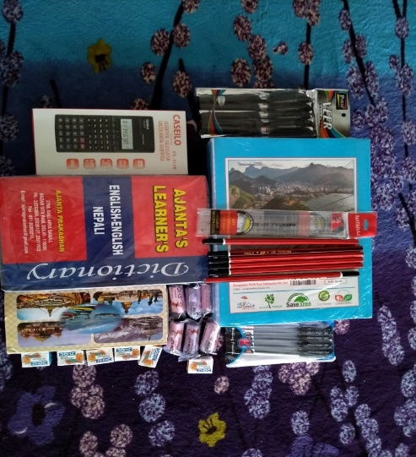
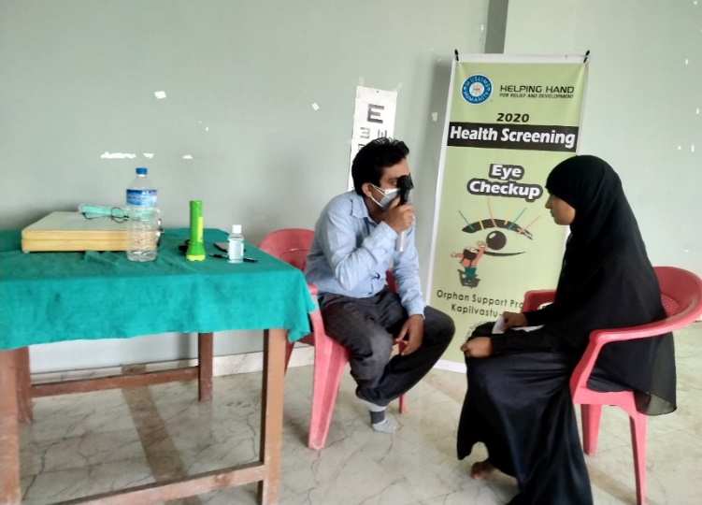
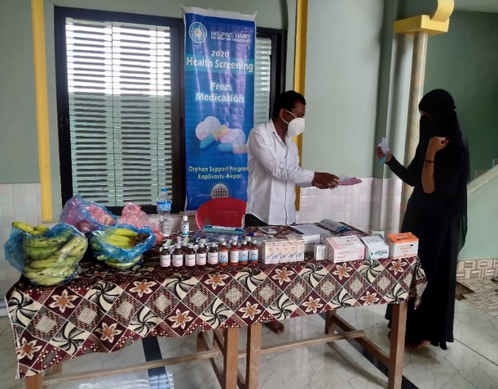
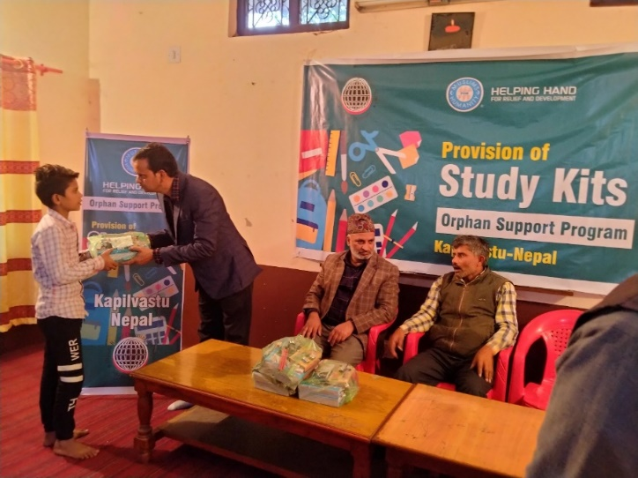
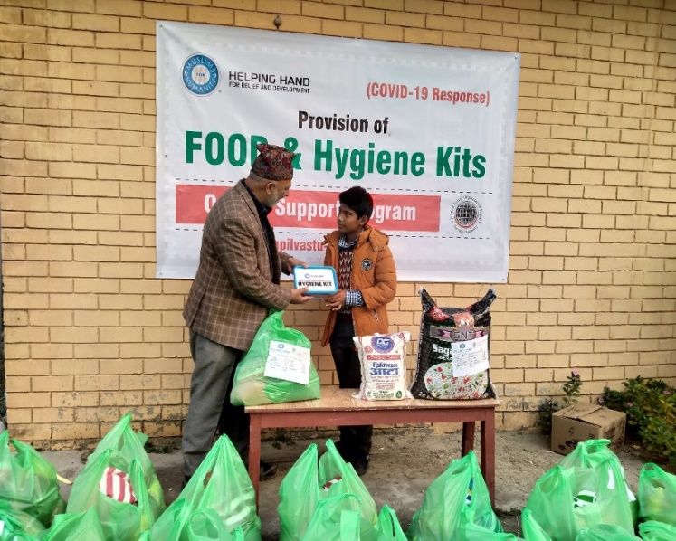
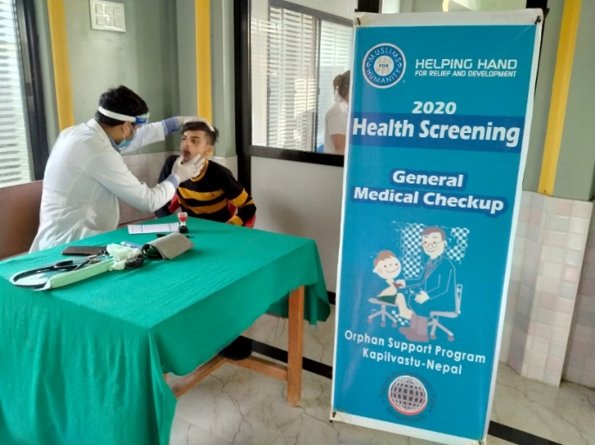
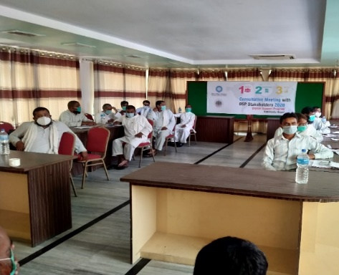
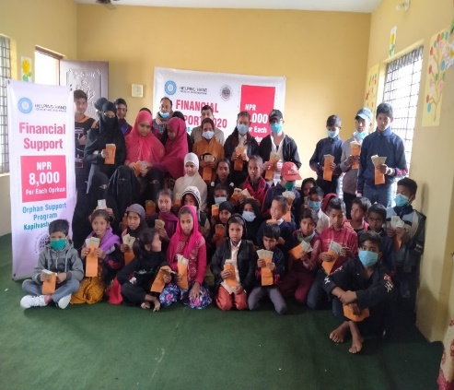
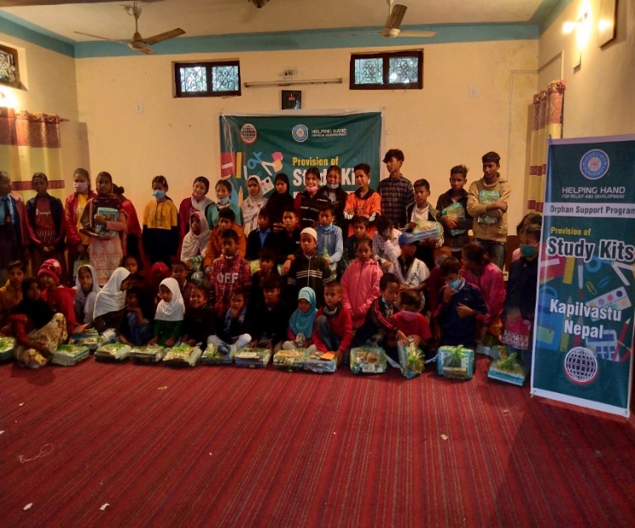
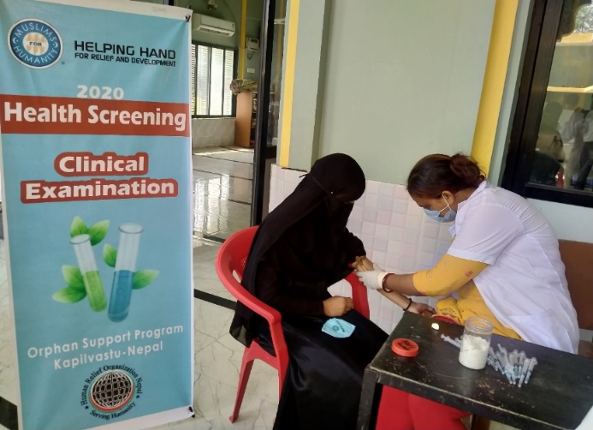
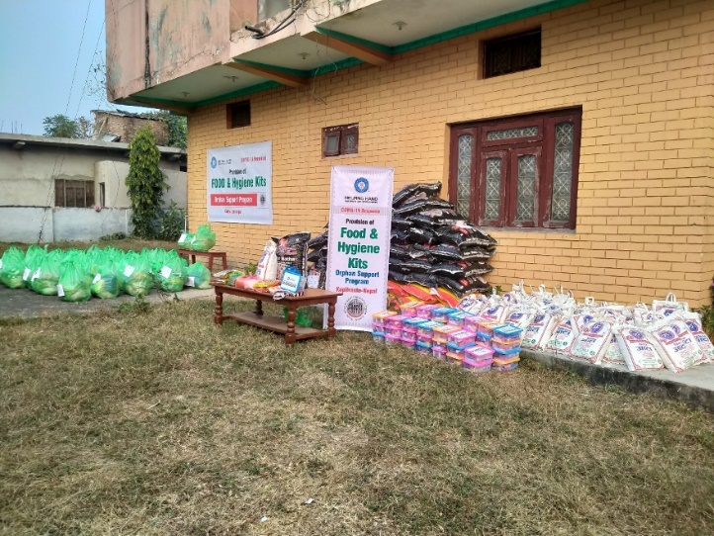

Slide 15

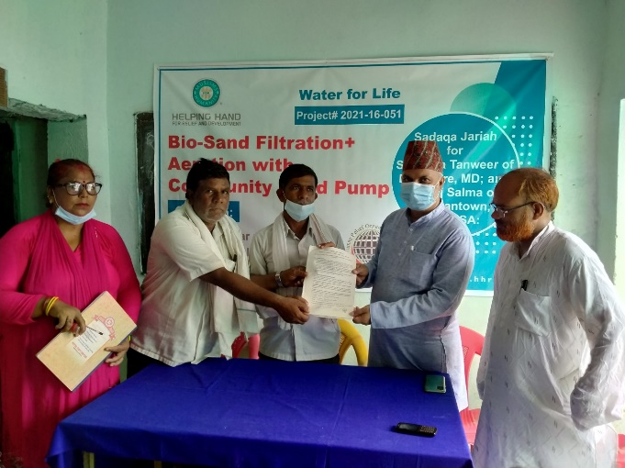
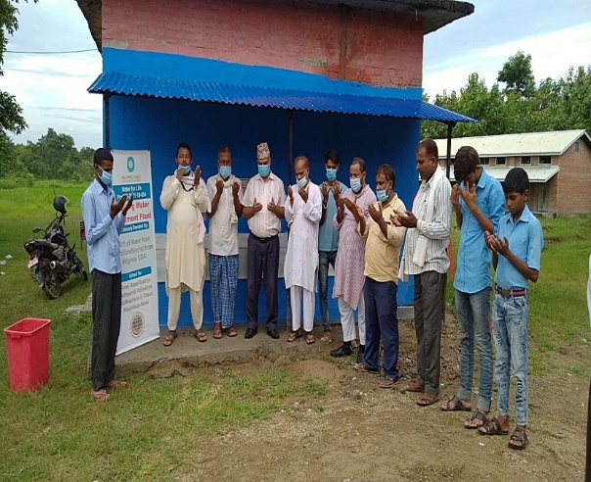
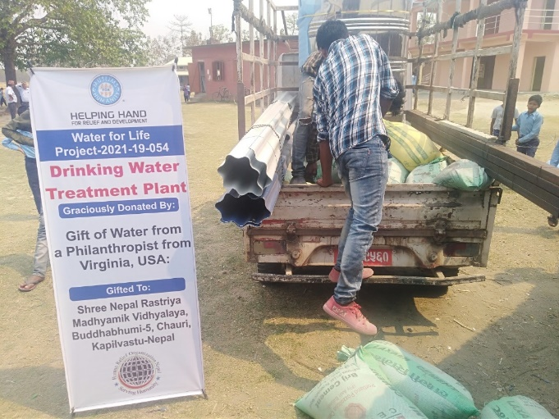
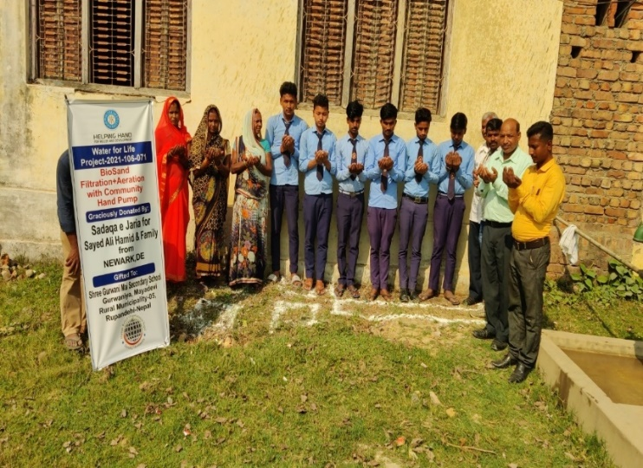
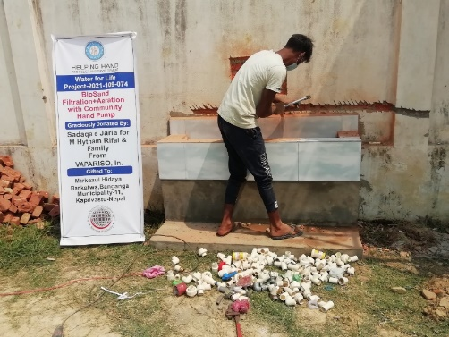
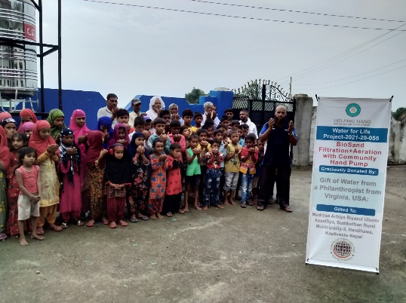
WASH – Water for Life
Access to clean water is a basic human right, yet many communities in Nepal still face challenges in securing this vital resource. Through our Water for Life project, HRO Nepal works to provide safe and pure drinking water to underserved areas by developing sustainable water systems, installing purification technologies, and promoting proper water management practices. This year, we successfully established (4) Drinking Water Treatment Plant and (10) Bio-Sand Filtration Plants with community pump, benefiting (5,120) students, teachers, community members, and households—improving health, hygiene, and overall well-being.

Slide 16
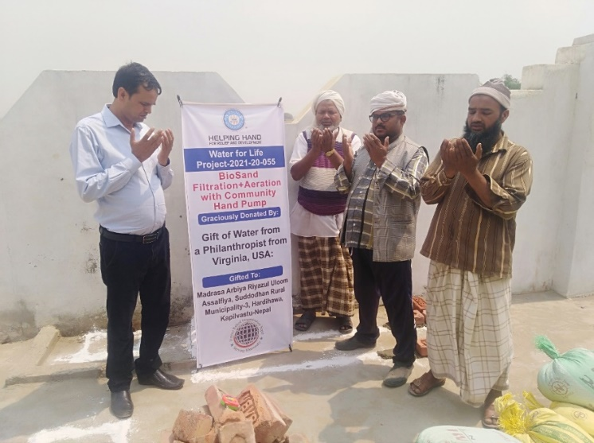
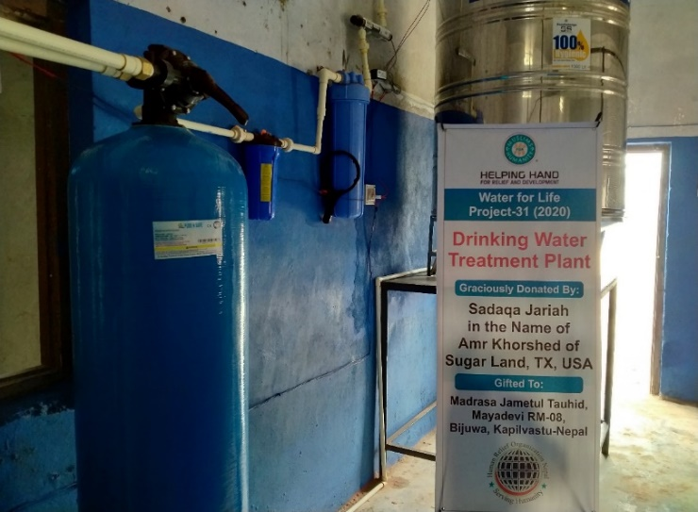
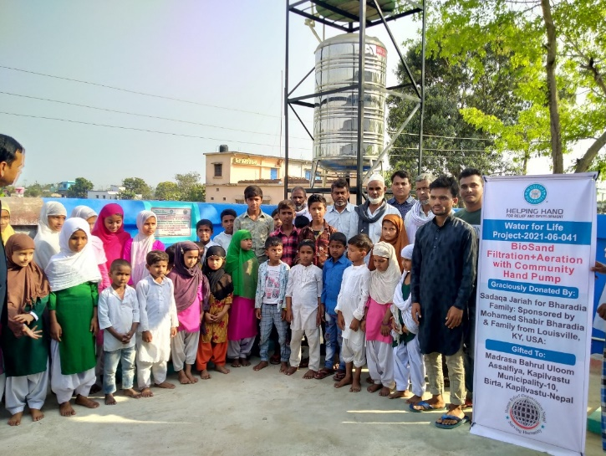
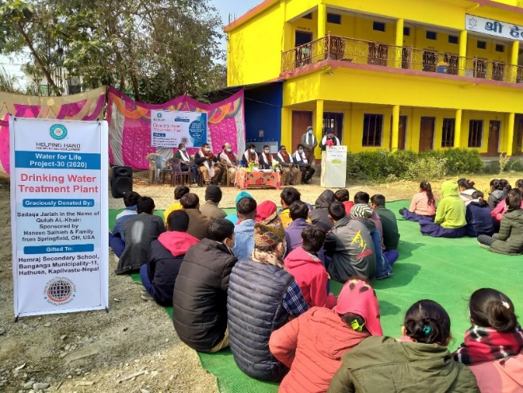
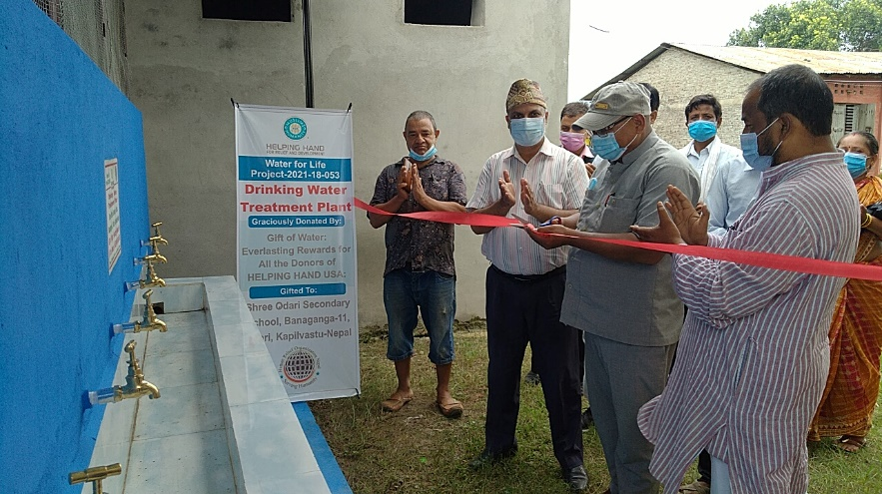
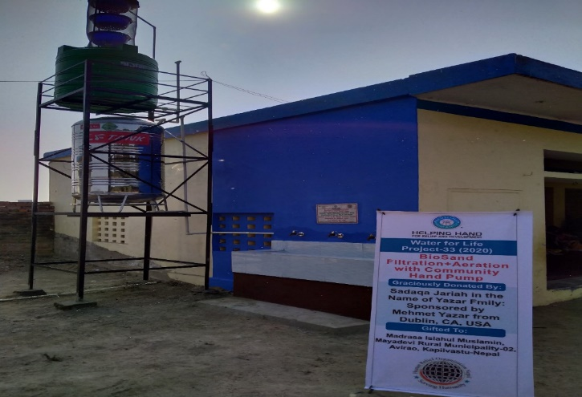




Slide 17




Seasonal Projects
HRO Nepal continues to respond to urgent needs through its seasonal projects, providing timely relief and support during natural disasters, crises, and periods of hardship. These initiatives play a vital role in alleviating suffering and restoring dignity among vulnerable populations.
During the year, HRO Nepal successfully implemented key seasonal initiatives, including the Ramadan Food Basket and Iftar Meals Program, providing essential food packages to impoverished families and orphaned children across multiple regions. These programs ensured that the holy month of Ramadan was observed with dignity, adequate nourishment, and a spirit of communal care. In total, 2,525 beneficiaries—including orphans, widows, and vulnerable families—were supported through these efforts.

Slide 18










In addition, the Qurbani Meat Distribution Program brought joy and nutritional support to underprivileged families during the Eid al-Adha celebration. Freshly slaughtered Qurbani meat was distributed to those in need, helping them partake in the religious occasion with dignity and inclusion. A total of (3,958) individuals benefited from this Project.
Through these seasonal efforts, HRO Nepal remains committed to standing with communities in times of need—offering hope, relief, and solidarity. We invite our partners and supporters to continue joining hands with us in transforming lives and building resilience across Nepal.

Slide 19










Slide 20






Slide 21






Winter Gift
for Nepalese
Orphans

Slide 22








Health Care
HRO Nepal is committed to improving access to quality healthcare for vulnerable communities. This year, we organized Free Medical Health Camps, Cataract Eye Surgeries, and Uterine Prolapse Screening programs, ensuring that marginalized individuals received timely diagnosis, treatment, and preventive care. In total, 1,100 vulnerable families benefited from these initiatives, helping to enhance their well-being and quality of life.

Slide 23










Slide 24

Impact 2020-2021
15+
13,428
200
5,120
50+
05
Orphan Students received essential aid, education, health care, and seasonal activities to ensure their well-being and holistic development.
Campaigns and social ventures designed to address social challenges
Children, students, women, and communities directly benefited from our projects.
Students and teachers are protected through access to safe and clean water.
Districts in Nepal reached with HRO Nepal Projects
Volunteers mobilized on ground to solve various types of social challenges

Slide 25

Financial Overview
Human Relief Organization Nepal
Income & Expenditure Account 2022-2023 (2079-2080)
S. N. | Income | Amount
1. | Previous balance | 2,677.71
2. | Helping Hand for Relief and Development | 9,379,057.50
3. | Al-I'tisam Relief Program Association | 589,963.55
4. | Children of Islamic Nation | 476,237.60
5. | Hidaya Foundation | 466,269.00
6. | International Humanity Relief UK | 387,300.80
7. | Others | 1,525,394.45
8. Membership |  | 10,000.00
Total |  | 14,117,598.30

Slide 26
S. No. | Expenditure | Amount
1. | Drinking water treatment plant | 1,922,082.99
2. | Bio-Sand filtration plant with community hand pump | 1,403,880.03
3. | Orphans Financial support Distribution | 2,046,485.00
4. | Provision of Food & NFIs | 477,635.00
5. | Provision of food & Hygienic kit | 521,900.16
6. | Free Cataract Surgery | 268,470.00
7. | Free Medical Camp | 184,570.00
8. | Health Screening | 224,271.00
9. | Provision of Hygiene Kit Distribution | 156,206.04
10. | Provision of Study Kits | 242,350.00
11. | Provision of Winter packages | 274,349.80
12. | Ramadhan Food Distribution | 1,014,200.00
13. | Eid Cash Gift | 166,380.00
14. | Co-Curricular Activities | 83,000.00
15. | Udhiya | 198,000.00
16. | One Million Meals | 252,000.00
17. | Family assistance to improve food security | 746,466.58
18. | Fresh meat for families living in poverty | 1,485,077.00
19. | Educational & welfare needs of Orphan children | 57,352.00
20. | Madrasa Support Project | 86,770.00
21. | Consultative Meeting with OSP Stakeholders | 50,020.00
 | Total

Slide 27

















Partner organizations
Human Relief Organization Nepal would like to pay a lot of thanks to our all partners for their financial and moral contributions on various projects in Nepal. Present and past partner organizations are as follows:

Slide 28












Contribution in SDG Goals
Human Relief Organization (HRO) Nepal is committed to fostering sustainable development and uplifting vulnerable communities through its impactful initiatives that align with the United Nations Sustainable Development Goals (SDGs). Our work across various sectors directly contributes to the realization of multiple SDGs:
Human Relief Organization Nepal sincerely acknowledges the unwavering support of our dedicated volunteers and community leaders. Your selfless contributions of time, effort, and influence play a vital role in advancing our mission and driving positive change.
We are deeply grateful for your continued commitment and for standing with us in our shared journey to build a stronger, more compassionate community.
7
8
9
10
11
12

Slide 29






Contact Us
To learn more about our organization, programs, and how you can get involved, please contact us at:
Human Relief Organization Nepal
Krishna Nagar Municipality, District: Kapilvastu,
Province: Lumbini, Nepal
Telephone: +977-76-520102
WhatsApp: +977-947040404
Email: info@hro.org.np
URL: http://www.hro.org,np/
Together, let's make a difference in the lives of those who need it most!

